Slide 1
Introduction to Professional Bodies
Literature Review Made Easy by Using Technical Publications Seminar
by James Hill,
on 17th July 2019,
in D45a Sackville Street Building

Slide 2
Outline
Who are the Professional Bodies?
What are the Professional Bodies?
What do Professional Bodies do / provide? (more coming later today)
How can you get involved?
Notes:
2

Slide 3
Who are (some) Professional Bodies
IEEE, CIGRE
Institute of Electrical & Electronics Engineers
International Council on Large Electric Systems
(Conseil International des Grands Réseaux Électriques)
IET
IMechE, InstMC, IChemE, CMI, IMarEST…
ANSI, ASTM, bsi, IEC…
Notes:
3

Slide 4
Who are Professional Bodies – Focus on IEEE
IEEE Mission:
“…to foster technological innovation and excellence for the benefit of humanity…”
Notes:
4

Slide 5
Who are Professional Bodies – Focus on IEEE - Where
422,460 members, according to 2018 annual report,
123,508 student members
https://www.ieee.org/communities/regional-world-map.html
Notes:
5

Slide 6
https://www.ieee.org/communities/societies/index.html
Notes:
6

Slide 7
Who are Professional Bodies – Focus on IEEE
Technical Society
Region
YOU!
Notes:
7

Slide 8
Who are Professional Bodies – Focus on IEEE - Provision
1,962 IEEE Conferences in 2018 (1,966)
57,628 journal articles published in 2018
6,496 Standards
https://www.ieee.org/content/dam/ieee-org/ieee/web/org/corporate-communications/annual-report/2018-ieee-annual-report-final.pdf
Notes:
8

Slide 9
“For the Benefit of Humanity…”
Affinity groups
Free to join
Look out for:
Women in Engineering (WiE)
Young Professionals (YP)
Notes:
9

Slide 10
Who are Professional Bodies – Focus on CIGRE
Purpose
To foster engagement and knowledge sharing among power system professionals globally to enable the sustainable provision of electricity for all.
Mission
To contribute to the betterment of the power system by enhancing the expertise of the people within it.
Vision
To be universally recognised as the leading global community for expertise in all aspects of electric power systems.
https://www.cigre.org/GB/about/introducing-cigre
Notes:
10

Slide 11
Who are Professional Bodies – Focus on CIGRE- Where
https://www.ieee.org/communities/regional-world-map.html
Notes:
11

Slide 12
Who are Professional Bodies – Focus on CIGRE- What
https://www.ieee.org/communities/societies/index.html
https://www.cigre.org/GB/knowledge-programme/our-16-study-committees-and-domains-of-work
Notes:
12

Slide 13
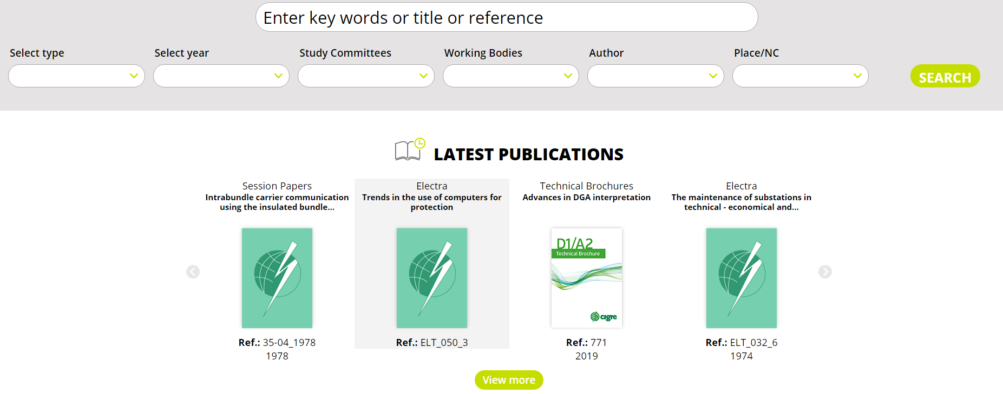
Who are Professional Bodies – Focus on CIGRE- Provision
Technical Brochures
Excellent summary of ‘current’ research
CIGRE Electra
‘Green Books’
CIGRE Paris Session
e-CIGRE
Notes:
13

Slide 14
How to Join - IEEE
Use the QR Code on your handouts
Start by joining the IEEE as a Student Member
Cost is ~$20 per year
Join today for a $13.50 half-year fee - Bargain!
Join your chosen society(ies)
Cost is ~$18 per year
Join today for a $9 half-year fee - Bargain!
(above based on PES)
Done! You can then join relevant affinity groups for free and make use of the benefits!
Notes:
14

Slide 15
How to Join – CIGRE-UK NGN
Use the QR Code on your handouts
Fill out the online form [and send proof of ‘studentship’]
CIGRE-UK NGN membership is free for all students for 4 years.
Notes:
15

Slide 16
(A non-exhaustive) Why to Join - IEEE
Conference fee discounts
(keep your supervisor happy)
Keep up to date with the latest developments and activities in your technical specialism
Access to publication library and training
Become part of a global community of like-minded people doing similar things
Looks good on CV / applications
Chartership
Notes:
16

Slide 17
(A non-exhaustive) Why to Join – CIGRE NGN
Access to NGN events
Access to e-CIGRE
Get involved in CIGRE activities:
Join international Working Groups
Join the NGN Steering Committee
Publish Papers in Working Groups and CIGRE conferences
Personal Development and route to Chartership
Understand what CIGRE is – make CIGRE work for you after graduation
Notes:
17

Slide 18
Thank you for listening
¿ Any Questions?
Notes:
18

